Slide 1

Digital Forensics Module
Open Source Forensic Tools Demonstration
WARNING!
Presented by:
Kyler Lee,
Dominic Lee

Slide 2
01
Case Scenario

Slide 3
Investigative Process
Case description
Called to analyze a hacker’s workstation
Relevant authorities were tipped off by an anonymous call about online cash theft
Alleged suspect, Terry Lee, suspected to be stealing money from vulnerable bank accounts
Wires the stolen money to himself
Objective is to find evidence that proves suspicious internet activity or suggests that the suspect might have done such things
WARNING!

Slide 4
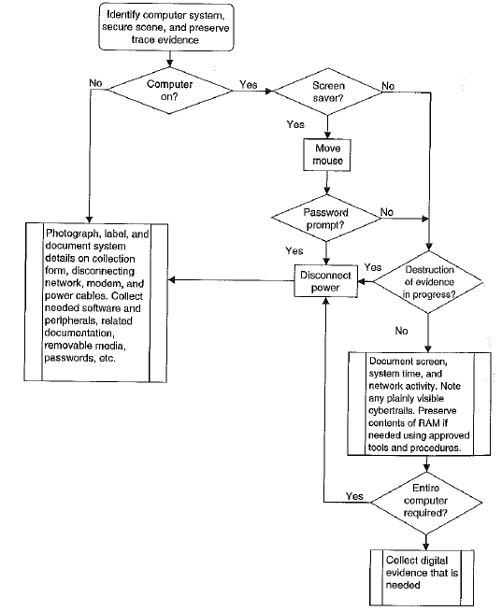
Investigative Process
WARNING!

Slide 5
02
Open-source Tools
CANCEL

Slide 6
The Sleuth Kit
03

Slide 7

Open-source Tool 1
THE SLEUTH KIT
Open-source forensic tool used for disk image analysis and file recovery.

Slide 8
What is The Sleuth Kit (TSK) ?
TSK is an open-source command line forensics toolkit
enables forensics investigators to perform identification, examination, and recovery of evidence from images acquired
retrieving deleted or hidden files or retrieving information stored in slack space
With the commands provided, it is possible to perform deeper analysis on raw images which can help provide insights about the evidence files.
Notes:
Single, cohesive framework that analyzes RAM dumps from 32- and 64-bit Windows, Linux, Mac, and Android systems
provide information about the image, running processes, networks, and files within the image
Volatility2 will be used over Volatility3 as it has a significantly greater number of plugins and features that can be used in the investigation
Regardless of version, it is a quick and powerful volatile memory forensics tool, and can be useful in analyzing volatile memory dumps

Slide 9
The Sleuth Kit - Functionalities
Functionalities of The Sleuth Kit Includes:
Partition Analysis - Lists partition tables to determine where each partition starts, how many partitions there are, what file system is being used, and identify gaps in the layout
String Search - Search for printable strings in files, can be used to identify keywords in files
File Signature Analysis - Searches for file extension and header mismatches
Data Recovery - Export both allocated and unallocated files into a local directory, able to recover deleted files
Notes:
Single, cohesive framework that analyzes RAM dumps from 32- and 64-bit Windows, Linux, Mac, and Android systems
provide information about the image, running processes, networks, and files within the image
Volatility2 will be used over Volatility3 as it has a significantly greater number of plugins and features that can be used in the investigation
Regardless of version, it is a quick and powerful volatile memory forensics tool, and can be useful in analyzing volatile memory dumps

Slide 10
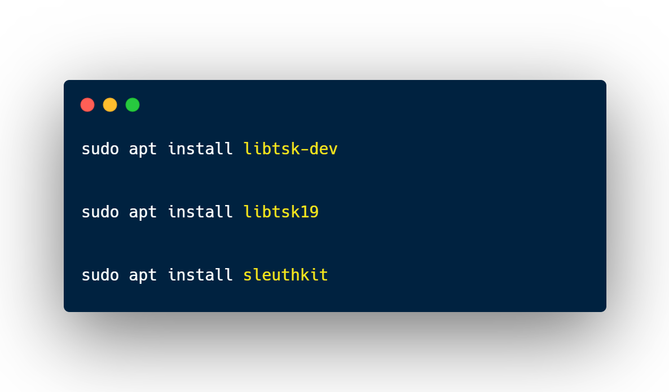
The Sleuth Kit - Configuration
TSK Installation
DANGER!
Before we begin the analysis of the imaged drive, we first have to establish the parameters used for analysis

Slide 11
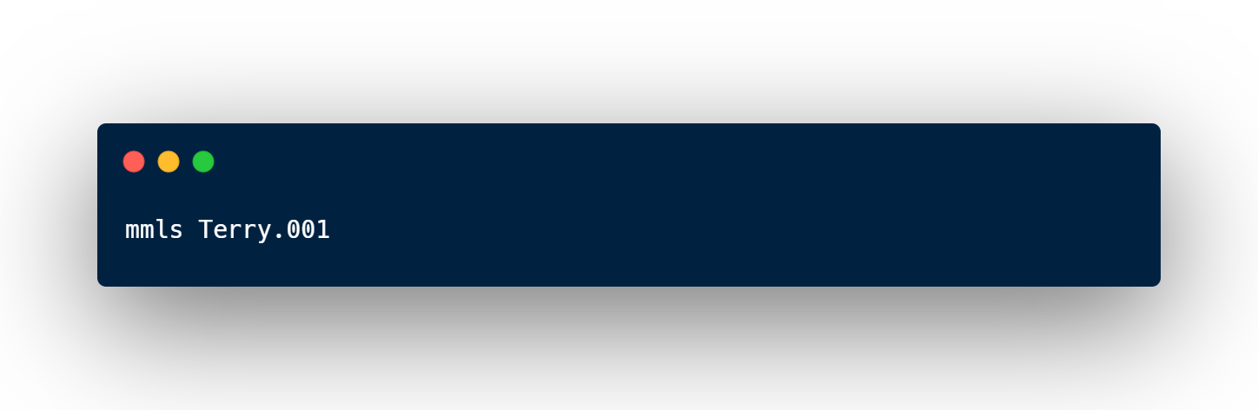
The Sleuth Kit - Configuration
Partition Analysis
DANGER!
mmls (multi media local system)
Displays the partition layout in a volume system
Includes partition tables and disk labels
Used for further image analysis parameters

Slide 12
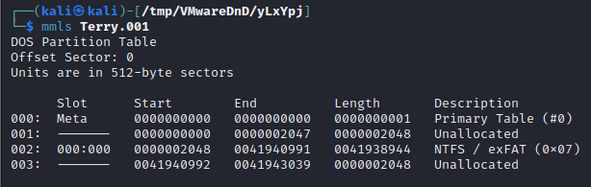
The Sleuth Kit - Configuration
Partition Analysis
DANGER!

Slide 13
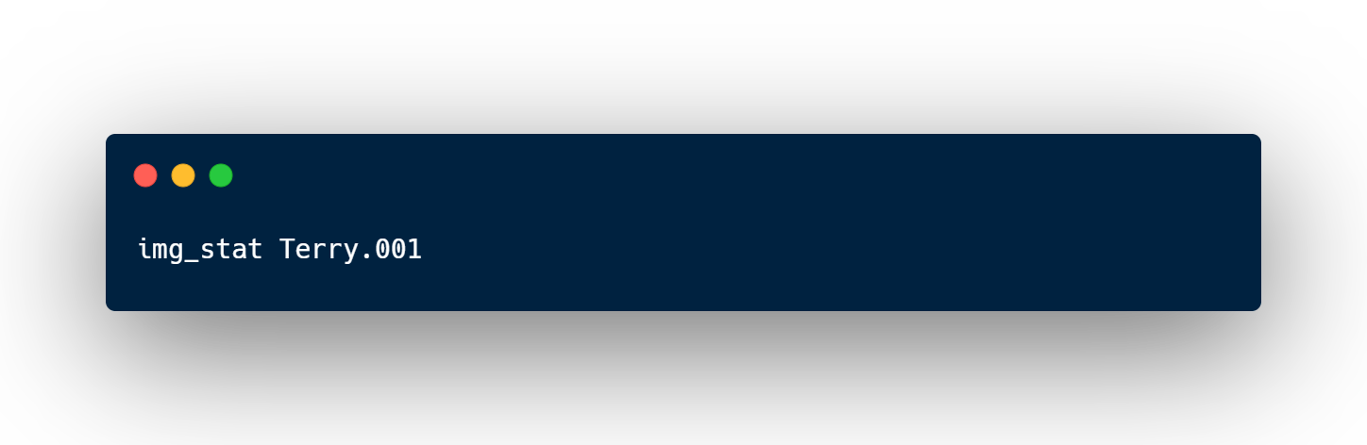
The Sleuth Kit - Configuration
Image Analysis
DANGER!
img_stat
Provides image type
Size of image
Sector size

Slide 14
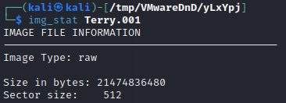
The Sleuth Kit - Configuration
Image Analysis
DANGER!

Slide 15
Volatility
03

Slide 16

Open-source Tool 2
VOLATILITY
Memory forensic tool thatcan analyses RAM dumps from windows, linux, mac and android system

Slide 17
What is volatility?
Command-line tool that analyze memory (RAM) dumps of computer systems
Often used by digital forensic investigators as RAM dumps could contain important and critical information
Opensource meaning users can customize plugins and inspect the code for modifications and enhancements
Notes:
Single, cohesive framework that analyzes RAM dumps from 32- and 64-bit Windows, Linux, Mac, and Android systems
provide information about the image, running processes, networks, and files within the image
Volatility2 will be used over Volatility3 as it has a significantly greater number of plugins and features that can be used in the investigation
Regardless of version, it is a quick and powerful volatile memory forensics tool, and can be useful in analyzing volatile memory dumps

Slide 18
Volatility - Functionalities
Memory dump analysis
Memory imaging
Timeline analysis
Malware detection
Plug-in architecture (Custom commands)

Slide 19
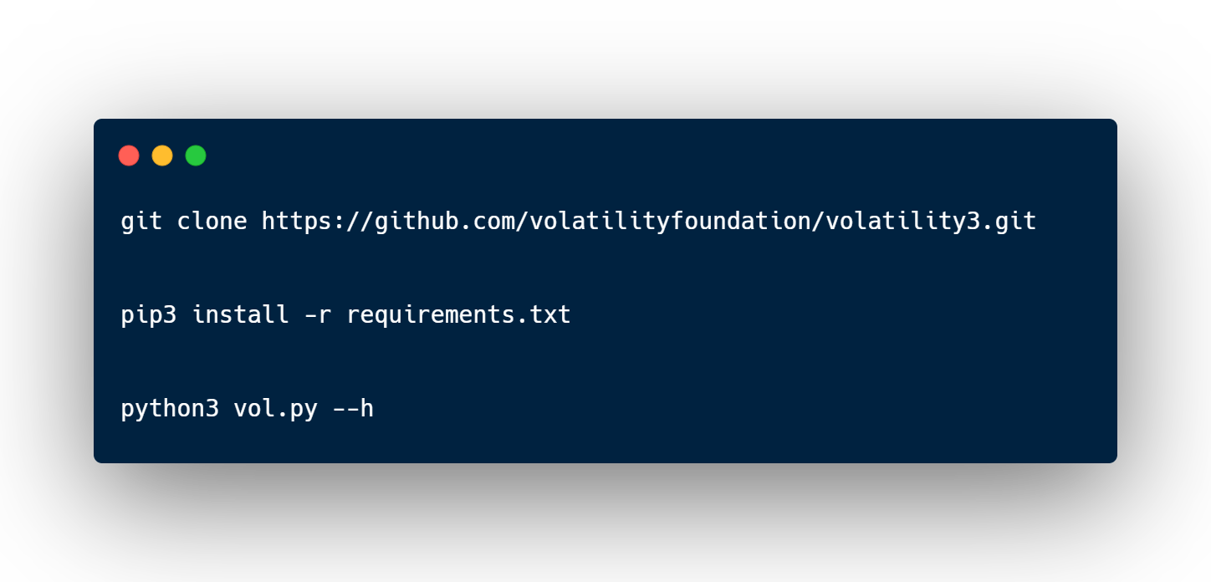
Volatility - Configuration
Note: This installation is for volatility 3
DANGER!
Notes:
1. git clone https://github.com/volatilityfoundation/volatility3.git
2. pip3 install -r requirements.txt
3. python3 vol.py –h

Slide 20
FTK Imager
03

Slide 21
FTK Imager
Tool used to create disk image and capture memory dump
Simple and efficient way to create disk images and preserve critical evidence
We both used FTK imager in order to generate a disk image and memory dump as evidence

Slide 22
04
Investigation Process

Slide 23
THE SLEUTH KIT

Slide 24
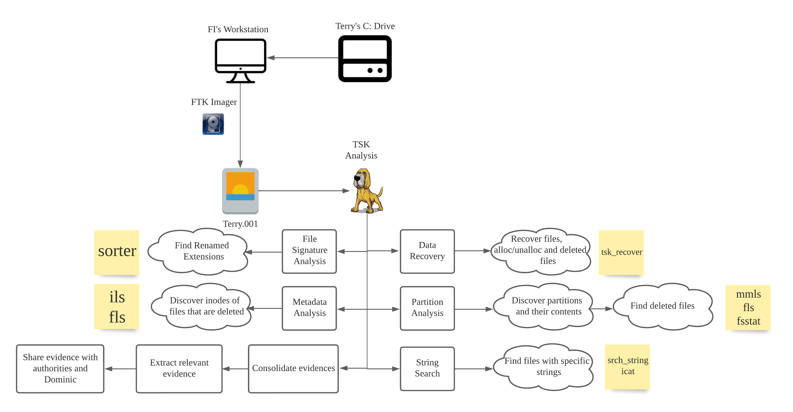

Flowchart
Write Blocker

Slide 25
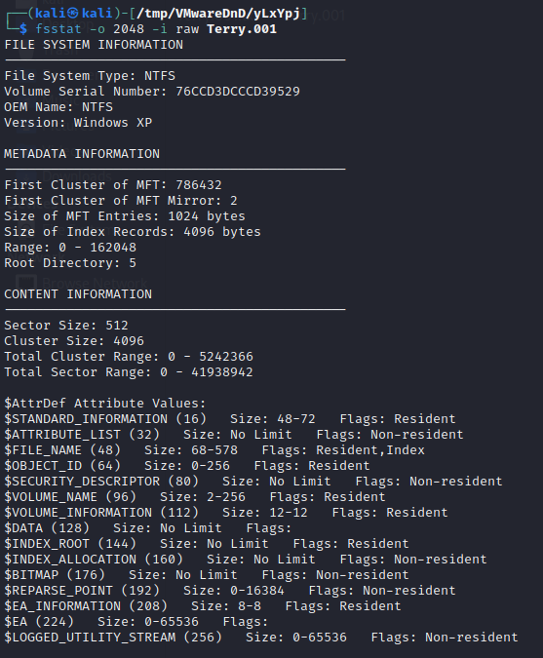
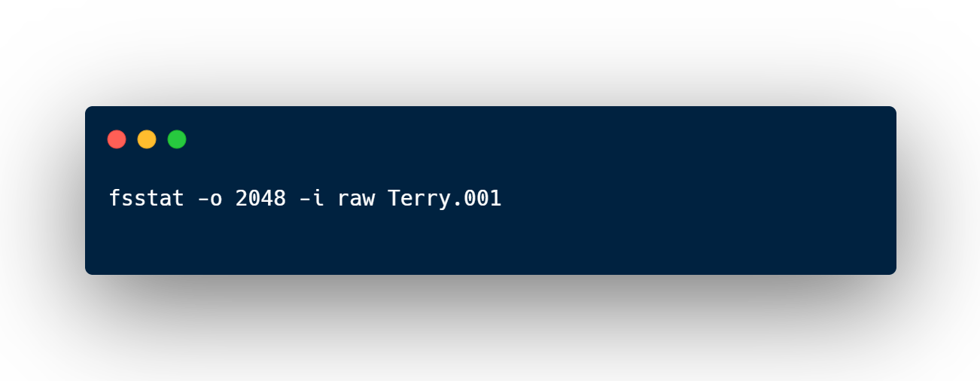
The Sleuth Kit - Investigation
Partition Analysis
fsstat (file system statistics)
Verifying File System Type
Determines File System Size
Identifies File System Layout

Slide 26
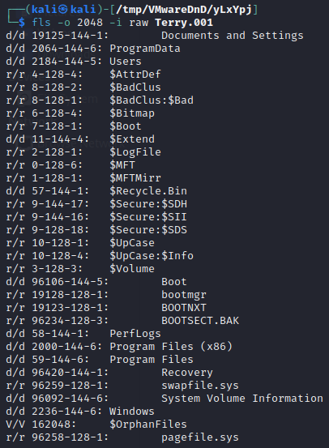
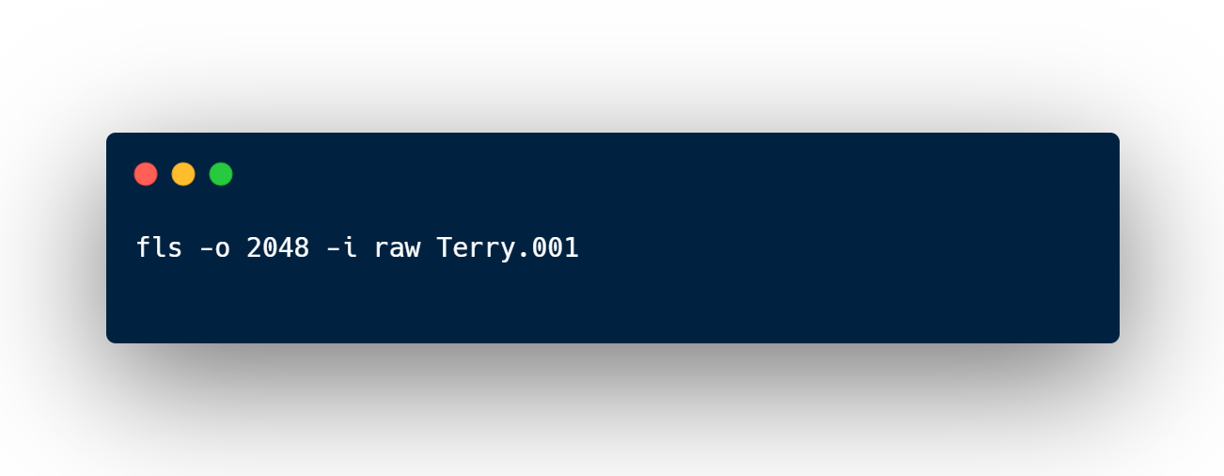
The Sleuth Kit - Investigation
Partition Analysis
fls (file listing)
Identify Files and Directories
Find Recoverable Deleted files/directories
Mapping File System Structure

Slide 27
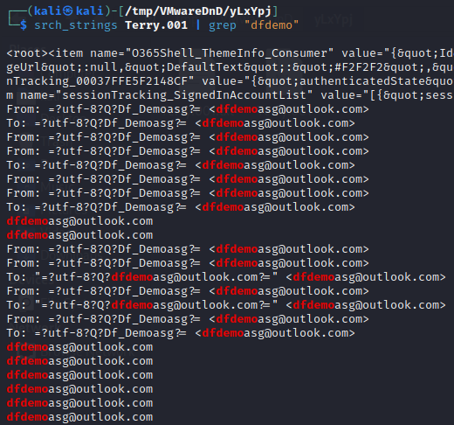
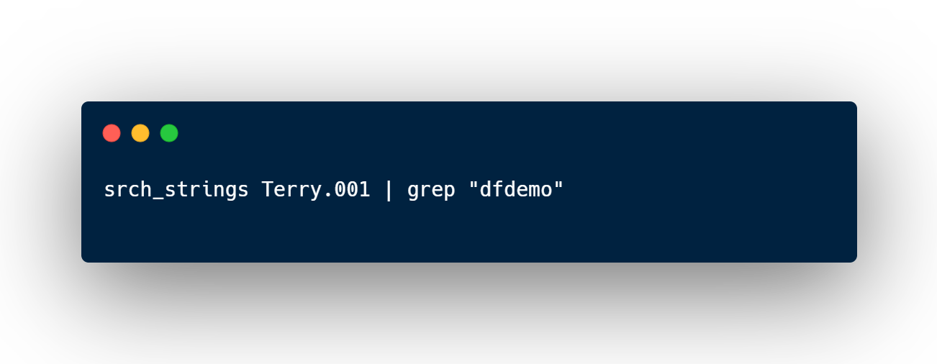
The Sleuth Kit - Investigation
String Search
Traces of email being sent, suggests that we should navigate to where emails from Mail application are stored at using fls and extract them with icat or tsk_recover.

Slide 28
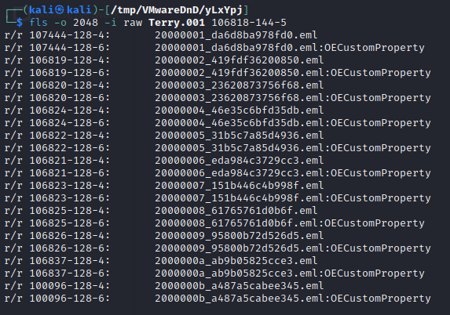

The Sleuth Kit - Investigation
Partition Analysis - Emails
By navigating to the subdirectory where the emails are stored from Mail application, we can then read and extract the .eml files
C:\Users\thomas\AppData\Local\Packages\microsoft.windowscommunicationsapps_8wekyb3d8bbwe\LocalState\Indexed\LiveComm\6bec57dcd8193478\120712-0049\Mail\1

Slide 29
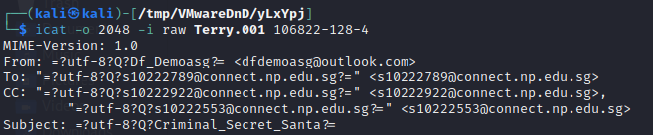
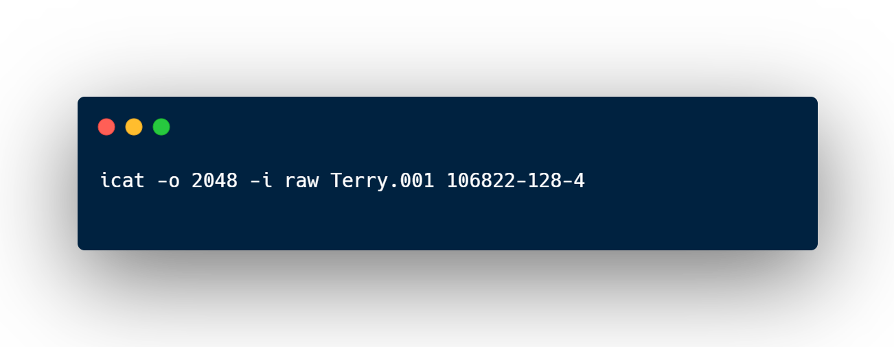
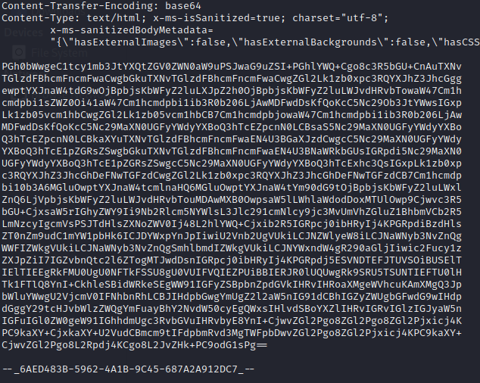
The Sleuth Kit - Investigation
Investigating Strings in File
With the use of icat, we were able to concatenate the contents of a .eml file with its inode to find text encoded in base64.

Slide 30
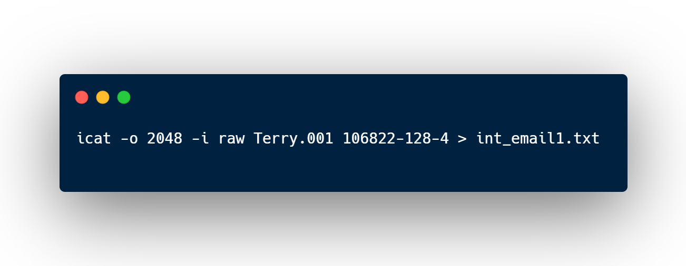
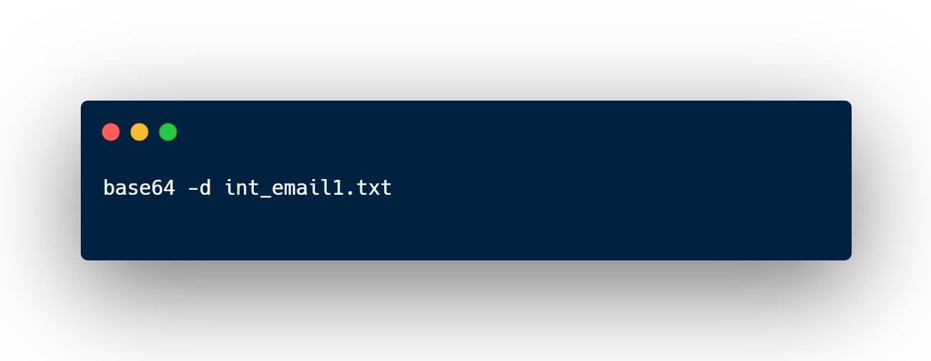
The Sleuth Kit - Investigation
Investigating Strings in File
By extracting the contents into a text file, and removing the non-encoded text above, we can decode it with base64.

Slide 31
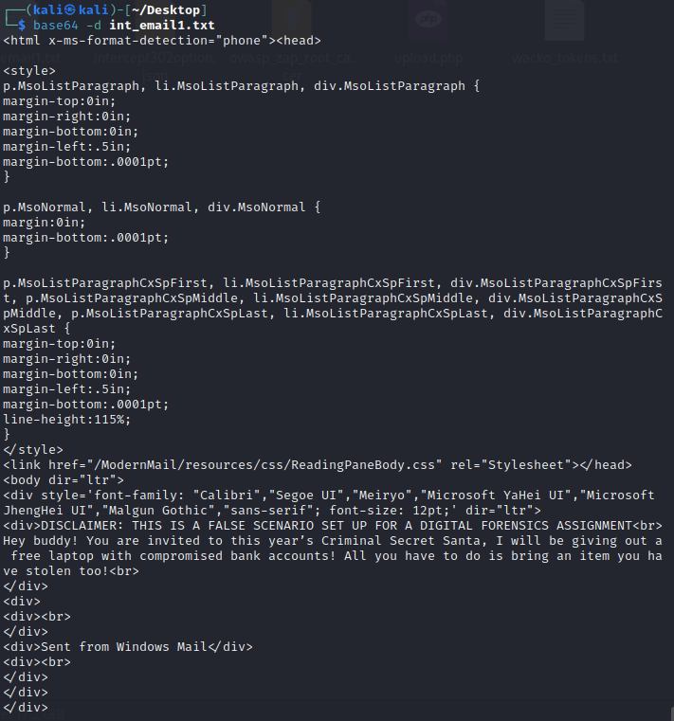
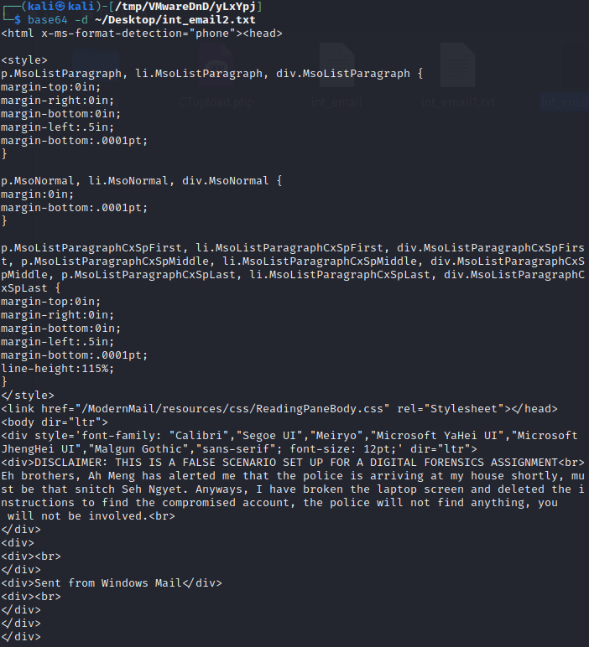

Slide 32
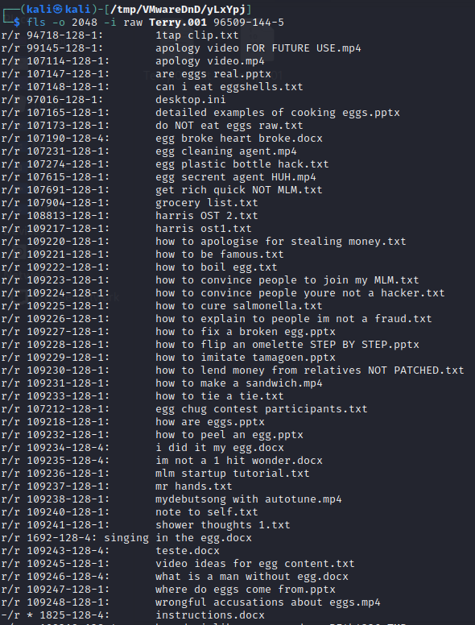

The Sleuth Kit - Investigation
Partition Analysis – Downloads folder
We can identify a deleted docx file named instructions.docx which we can recover with tsk_recover
Notes:
Navigate to downloads folder

Slide 33
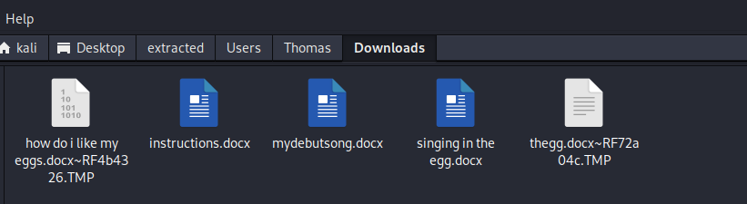
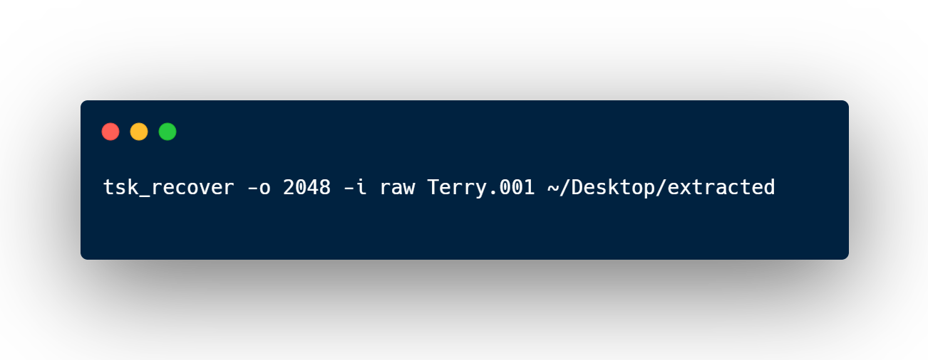
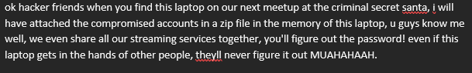
The Sleuth Kit - Investigation
Data Recovery
After extracting the docx file and transferring it to my Windows machine to open it, we are able to see that there is a zip file hidden in memory and the password is corelated to his passwords for streaming services
Notes:
Navigate to downloads folder

Slide 34
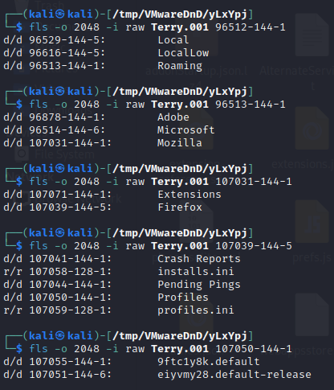

The Sleuth Kit - Investigation
Partition Analysis – Browser History
We can now navigate to the sub-directory where the Firefox browser history is stored and extract the .sqlite files to analyse
C:\Users\Thomas\AppData\Roaming\Mozilla\Firefox\Profiles\eiyvmy28.default-release

Slide 35
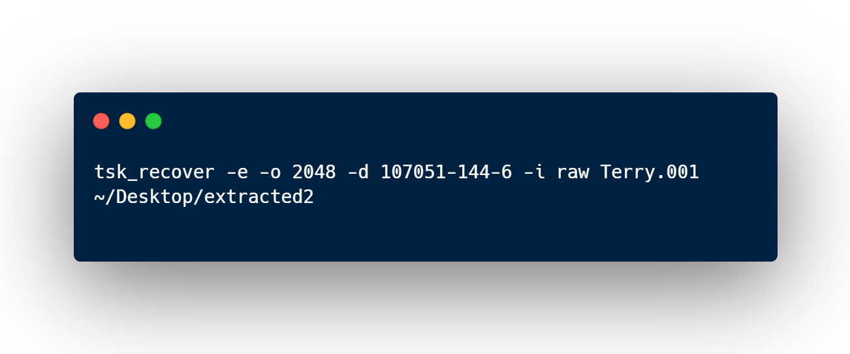
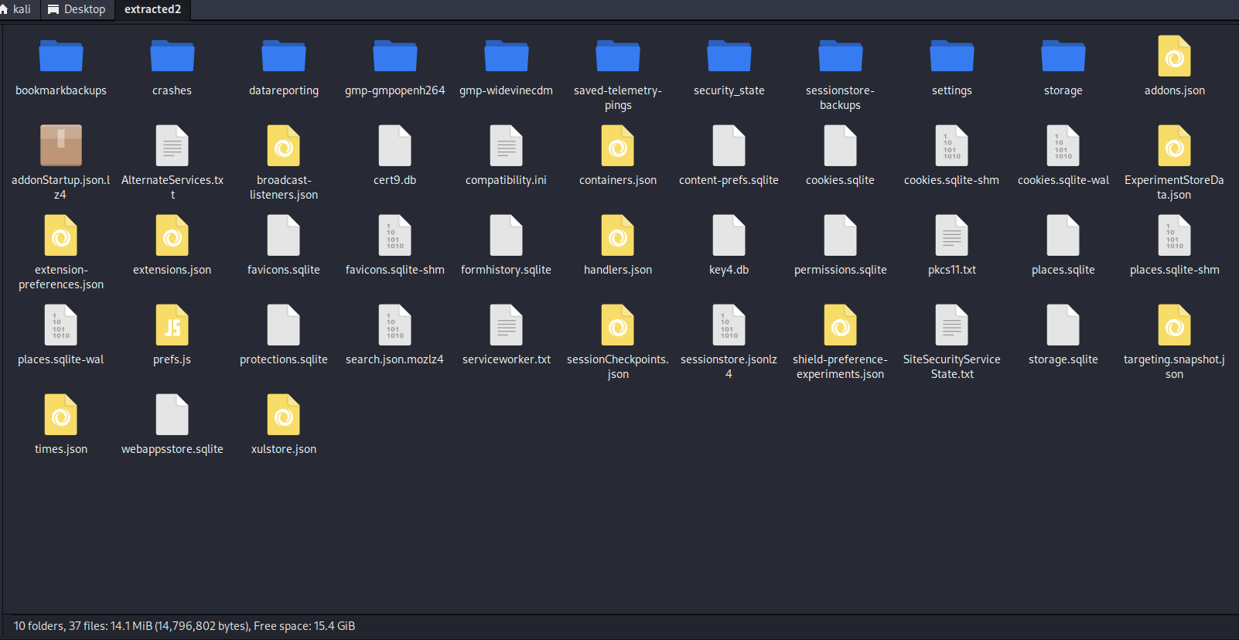
The Sleuth Kit - Investigation
Data Recovery
Using tsk_recover to extract the files, we can then analyse places.sqlite to read Terry's browser history

Slide 36
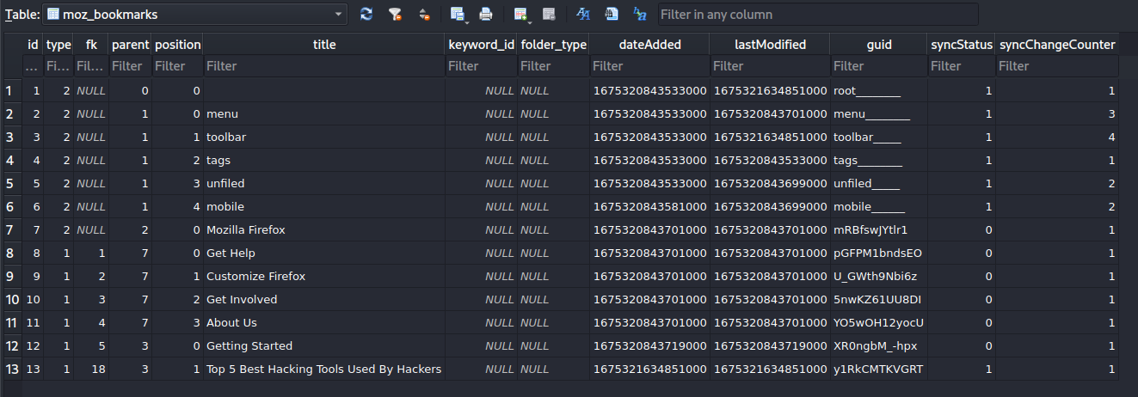
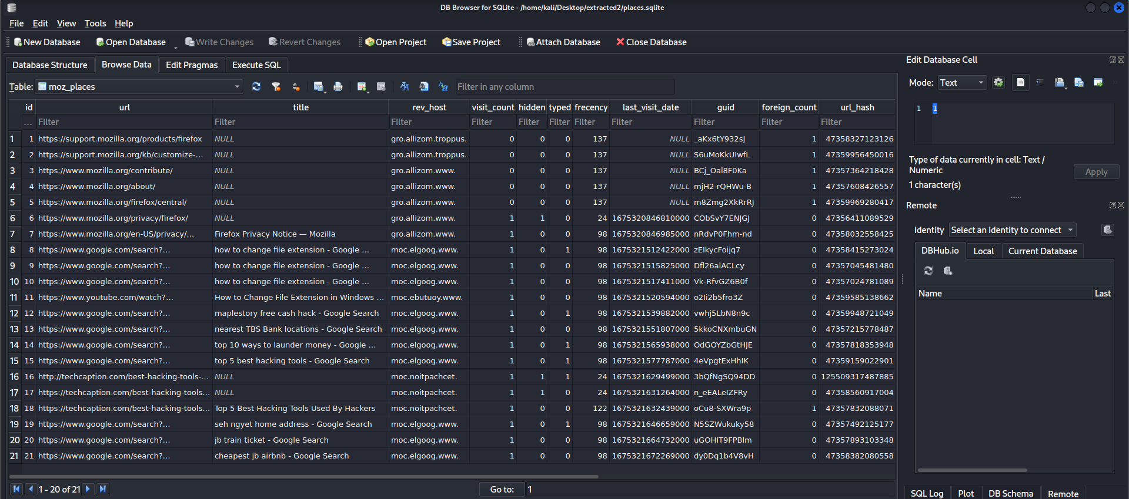

Slide 37
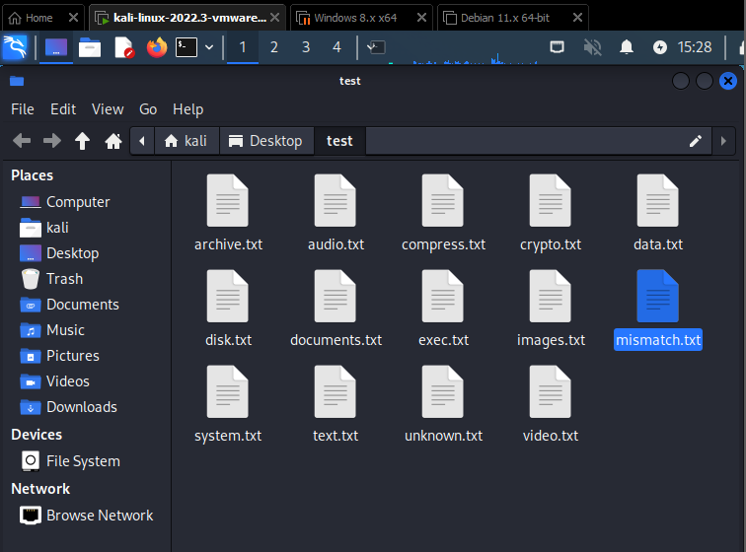
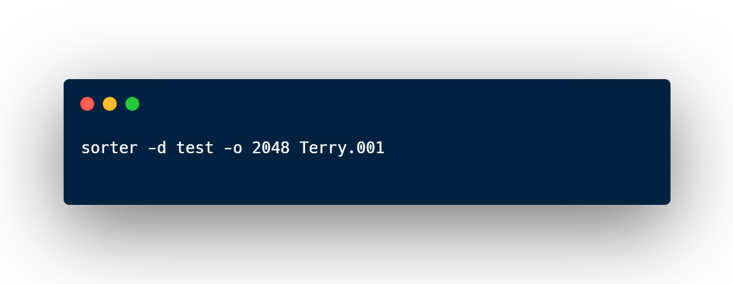
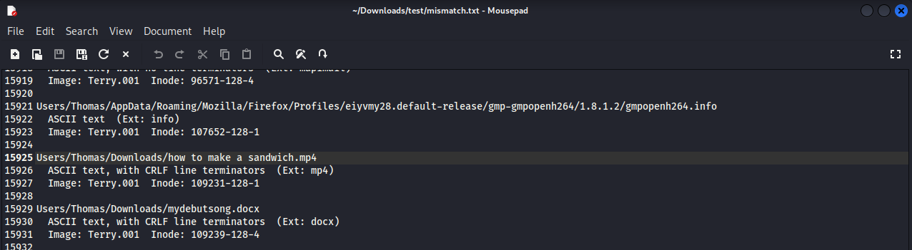
The Sleuth Kit - Investigation
File Signature Analysis
From the output, we can see from the mismatch.txt file that there is a .mp4 file where the header and extension does not match

Slide 38
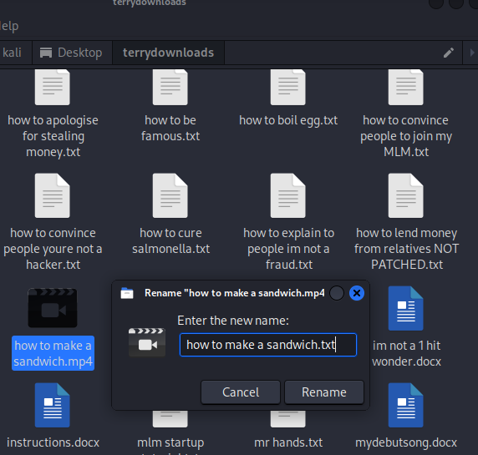
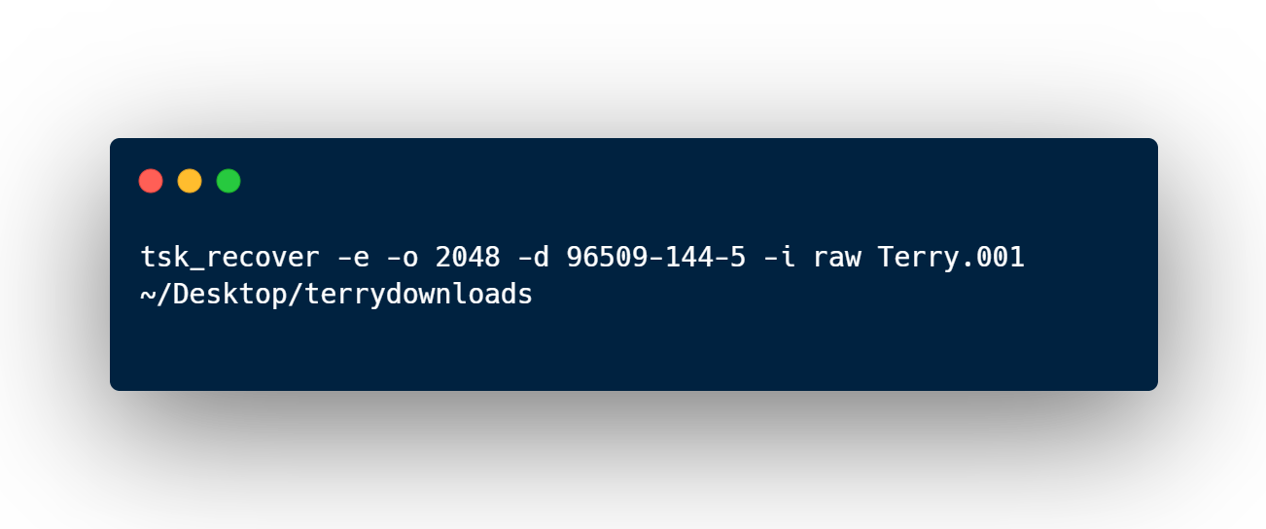
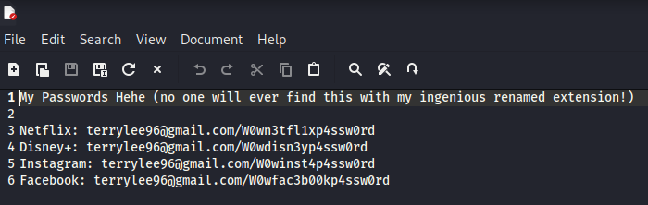
The Sleuth Kit - Investigation
Data Recovery
After extracting and renaming the .mp4 file to a .txt file, we are able to find a text document with Terry's passwords (infer that the zip password is: W0wz1pp4ssw0rd)
Notes:
Navigate to downloads folder

Slide 39
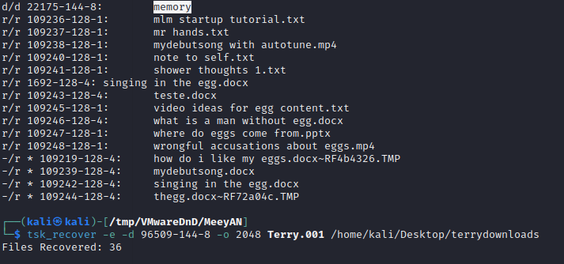
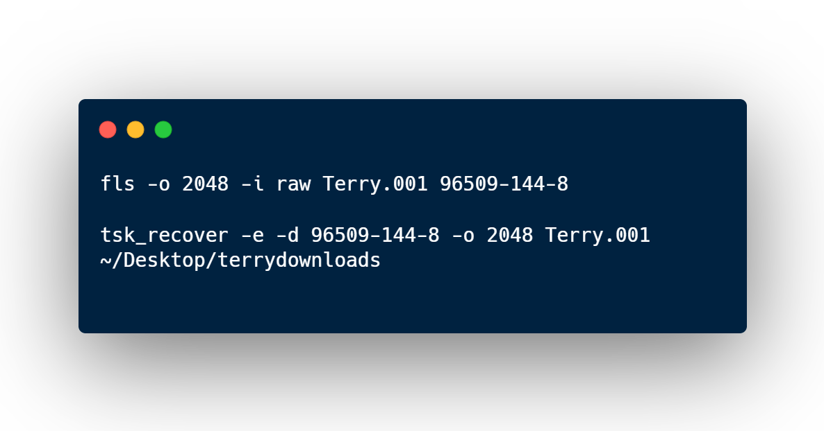
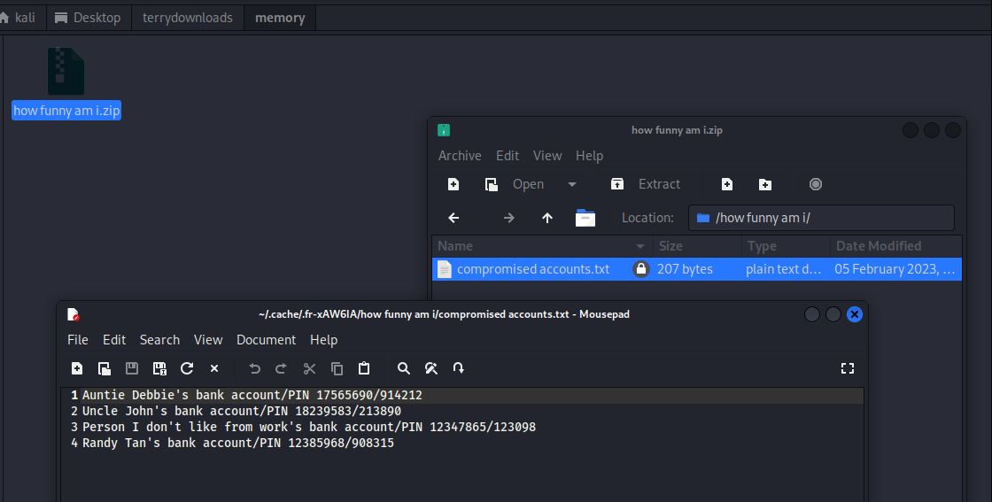
The Sleuth Kit - Investigation
Partition Analysis – Downloads folder
By navigating to the downloads folder, we can see a memory folder with a password-protected zip file in it, by using the password W0wz1pp4ssw0rd, we managed to acquire the compromised accounts
Notes:
Navigate to downloads folder

Slide 40
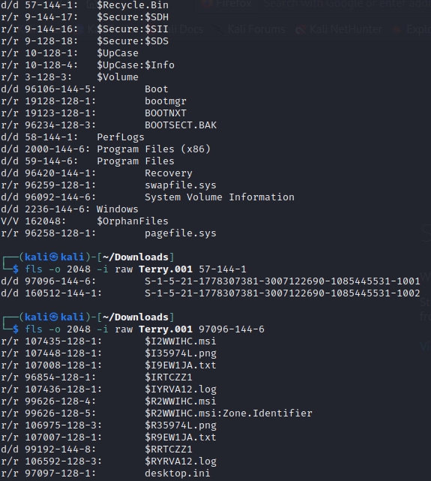
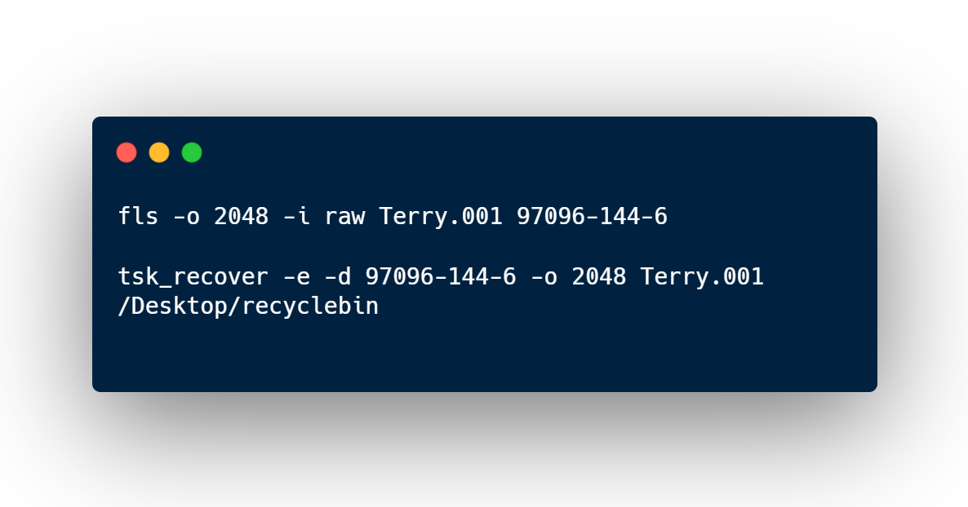
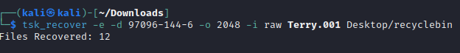
The Sleuth Kit - Investigation
Partition Analysis – Recycle Bin
By navigating to the Recycle Bin folder, we are able to find one interesting image after extracting it with tsk_recover

Slide 41
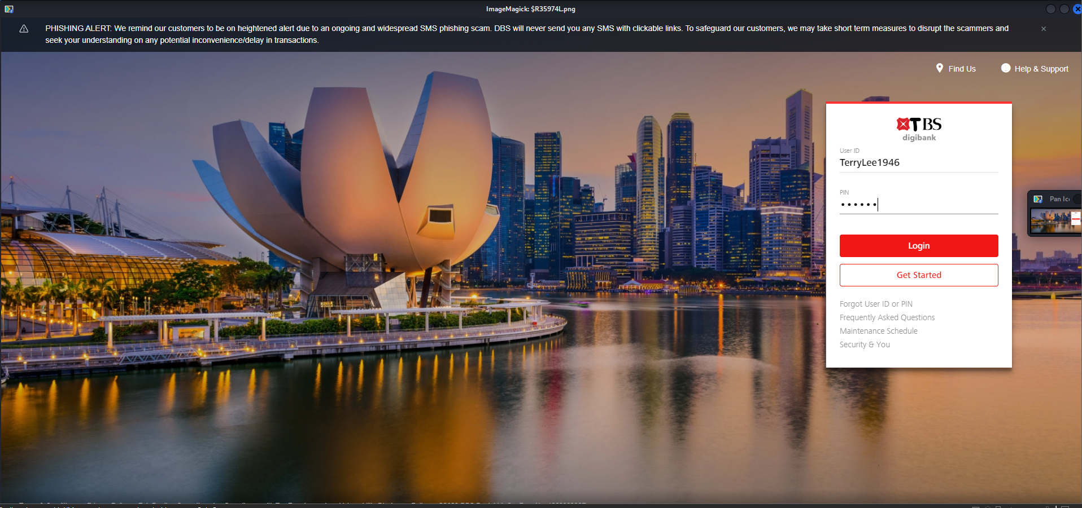

Slide 42
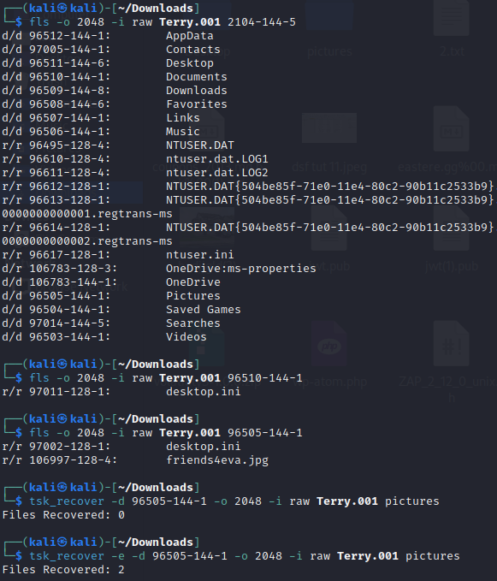
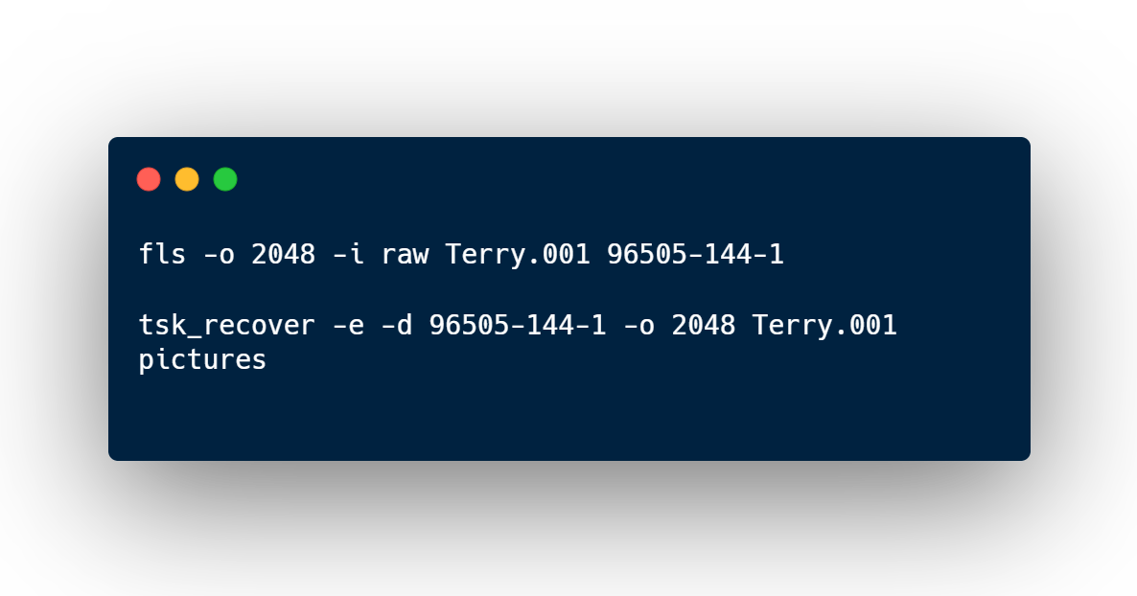
The Sleuth Kit - Investigation
Partition Analysis – Pictures folder
After navigating to the pictures folder, we can identify another interesting picture and extract it with tsk_recover
Notes:
Navigate to downloads folder

Slide 43
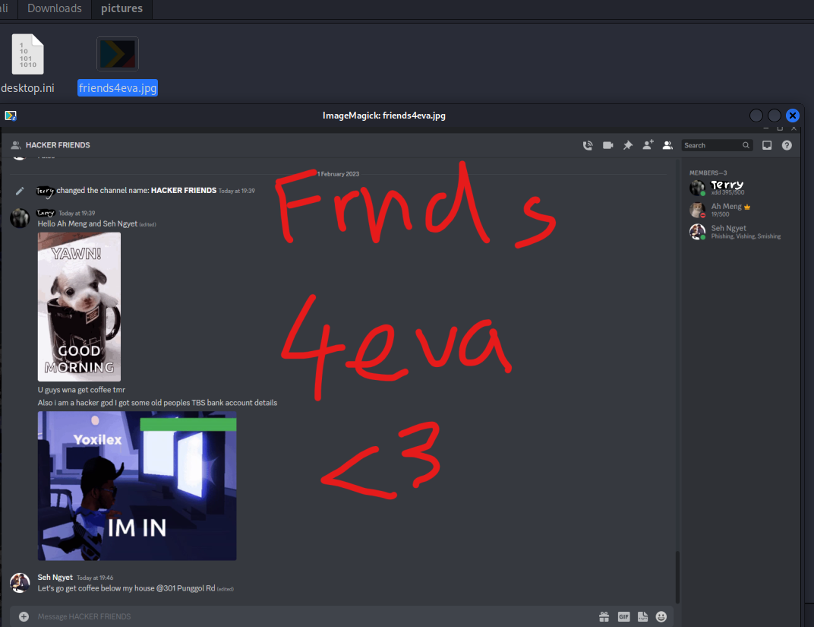

Slide 44
Overall Findings
Found evidence in web browser history, downloads, pictures, and mail folder using the fls, tsk_recover and icat commands
Extracted deleted files and analysed them to find hidden instructions using tsk_recover
Found strings containing email of suspect in folder using srch_string command
Found a renamed file with a mismatched header and signature using sorter command
Gained information on partitions and file systems using mmls and fsstat command

Slide 45
Open-source Tools
VOLATILITY

Slide 46
Flowchart
1. Admin Info
2. Process Info
3. Connection Info
Imageinfo
Pslist
Pstree
Netscan

Slide 47
Flowchart
5. Dumping Files
4. Command History
6. Cracking Paasswords
Cmdline
Handles
File scan
Dumpfiles
Hashdump

Slide 48
Explanation
Important to have a comprehensive analysis of the memory file
First gain basic information of the memory dump
Check for evidence through analysis of processes, network information, and command line commands
Finally extract relevant evidence based on information found in these areas
These are the main areas of a memory dump that usually contain key evidence

Slide 49
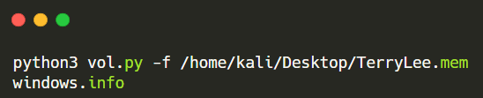
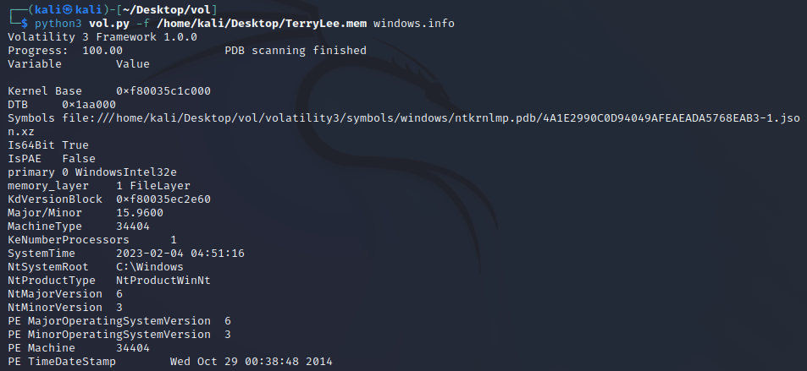
Administrative Info (‘imageinfo’)

Slide 50
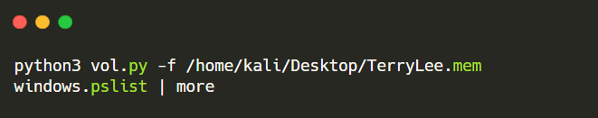

2. Identify Running Processes (‘pslist’)
This command shows information of processes running such as the PID, PPID, and number of process.
Allows us to scan for interesting/malicious processes

Slide 51


3. Finding Parent Processes (‘pstree’)
We then used ‘pstree’ to identify the parent process of the processes we were interested in
Chrome.exe main parent process is PID = 3044, notepad.exe & cmd.exe parent process is explorer.exe PID = 1628
Notes:
Check for malicious processes. Might have disguised as a legitimate process

Slide 52


4. Identify connections (‘netscan’)
Displays information about network connections and sockets
Allows us to identify active connections, open ports and process info
Detect malicious connections
Here we see that the Process ‘chrome.exe’ connects to a foreign addr 23.54.57.250 through port 443

Slide 53


5. Command History (‘cmdline’)
Extracts command line arguments from the different processes
Here we see where the different processes were ran from
Also shows the full path of the 11.txt file
Allows us to check if any processes were started from suspicious locations. None were found
Notes:
Check for malicious processes. Might have disguised as a legitimate process

Slide 54

6. Extracting Chrome History (‘handles’)
The command ‘windows.handles’ extracts all the handles from the process specified
Handles can be anything from a file, to a registry key, to a semaphore
Here, we want to extract the chrome history file as that allows us to see what the suspect had browsed before his laptop was seized
Notes:
Check for malicious processes. Might have disguised as a legitimate process

Slide 55


7. Dumping the file (‘dumpfile’)
The command ‘windows.dumpfile’ extract a specific file from the memory image and saves it to the disk
This allows us to extract the file from memory and view it
Here the file is dumped into the directory ‘history’ and the next step is to view the contents of it
Notes:
Check for malicious processes. Might have disguised as a legitimate process

Slide 56

8. Viewing the History file
Searched on ‘How hackers hack credit cards’
Visited ‘Metasploit’
Visited OCBS, CIMB and UOB login pages.
Notes:
Check for malicious processes. Might have disguised as a legitimate process

Slide 57


9. Locating Files (‘filescan’)
There was a process called ‘notepad.exe’ indicating that there was a file open on the computer in a .txt format
From here we see that the a file called ‘11.txt’ was opened and was stored on the user’s desktop folder
We were unable to dump the file as no file could be outputted. Here the file could be corrupted
Notes:
Check for malicious processes. Might have disguised as a legitimate process

Slide 58


10. Cracking Passwords (‘hashdump’)
Hashdump commands show the hashes for the different user accounts
We see that the user account ‘Thomas’ has the same hash as the guest account which does not have a password
If it was different, we would use an online hash cracker to decrypt it
This gives us access to Thomas’ account
Notes:
Check for malicious processes. Might have disguised as a legitimate process

Slide 59
Overall Findings
Found evidence in the history file of the chrome process
Found out the password or lack of password of the user using hash dump
Found out the name of the notepad file that was open before the memory dump

Slide 60
05
Demonstration

Slide 61
06
Conclusion & Reflection

Slide 62
Conclusion – Tools, The Sleuth Kit
TSK is a useful tool for navigating directories, searching and extracting files from acquired images.
One of the better documented tools but still largely undocumented and made it very tedious to use.
TSK feels better used in conjunction with another tool rather than used alone for image analysis

Slide 63
Conclusion – Tools, Volatility
Volatility is a useful tool for analysing memory dumps of an image file
It has much more memory-related capabilities for analysing memory dumps and is a great tool to use in conjunction with TSK.
Able to have a comprehensive analysis on a memory image using volatility
Can find and extract many evidences through appropriate use of it

Slide 64
Conclusion – Case Scenario
Found lots of evidences indicating suspect Terry Lee is the perpetrator of the compromised bank accounts.
Found email and home address of other hackers that may be related to Terry.
Found the compromised bank accounts
Found evidence of Terry searching for hacking tools and attempting to flee to JB
Confirmed Terry is using metasploit keylogger (?) to steal user credentials, should notify authorities/TBS about this

Slide 65
Reflection - Kyler
A forensics investigation is hard work, from evidence acquisition to its analysis, it is a process that should be well-documented and requires the FI to be consistent.
Utilising command-line tools has also allowed me to better understand the use of tools such as TSK and their capabilities. It has also helped me understand that the tools are limited, and that we should incorporate other tools together to fully analyse an image
Overall, this assignment has been very meaningful as it has helped me step into the shoes of a forensics investigator and better understand its job scope.

Slide 66
Reflection - Dominic
Gained deeper insight into a forensic investigation from how it is carried out to how to perform it
Learnt how to properly use and configure the tools used and also learned about many tools during the research process
Learnt how to think of a case scenario as well as appropriately find and craft evidence
Learnt more about the tools available in digital forensics and that it is important to use different tools to analyse as much as possible to gain the best understanding
Important to analyse all forms of media (Memdump, disk image)

